Slide 1
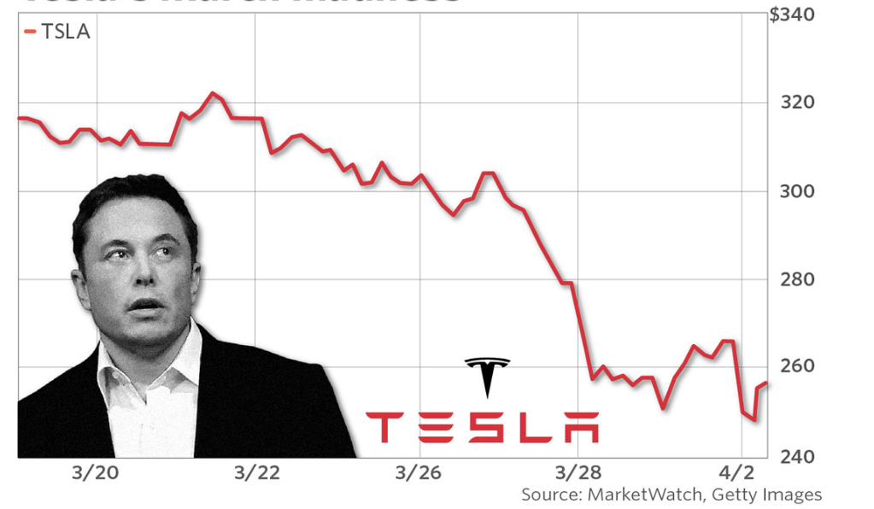

Regime-Switching for
Risk Insights:
A Case Study on Tesla (Q1 2025)
04.23.2025
LOKANA SHANKARA
ls1526
Inspired by real-world volatility insights for Tesla leadership

Slide 2
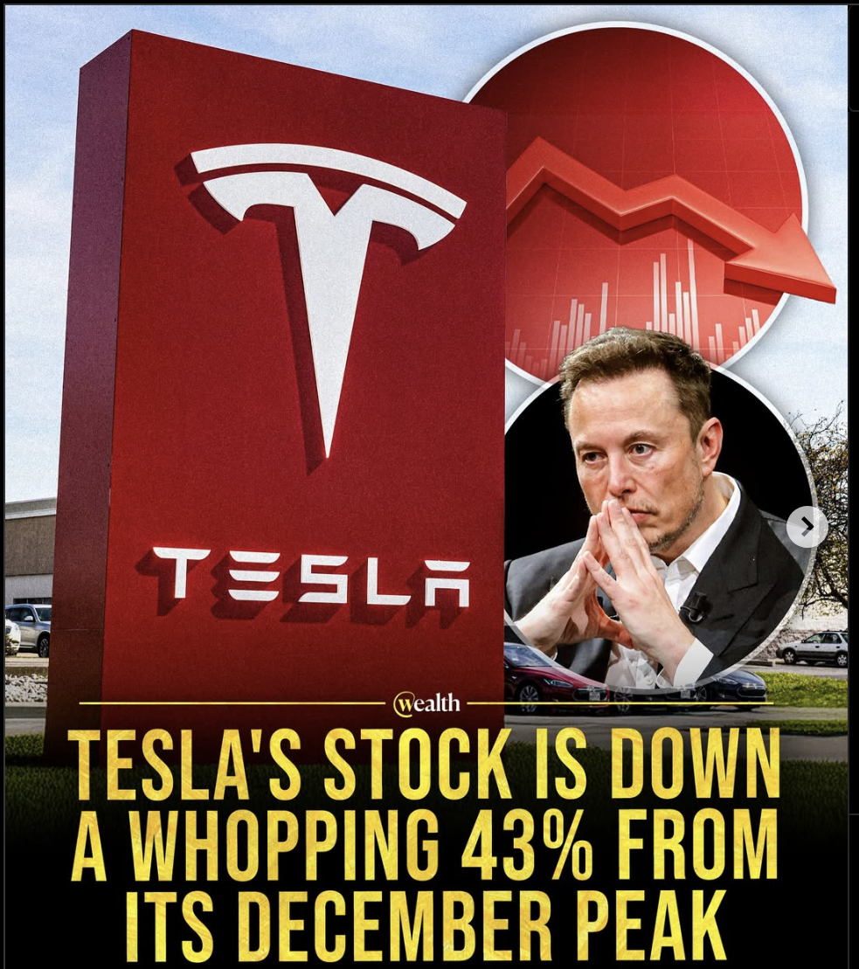
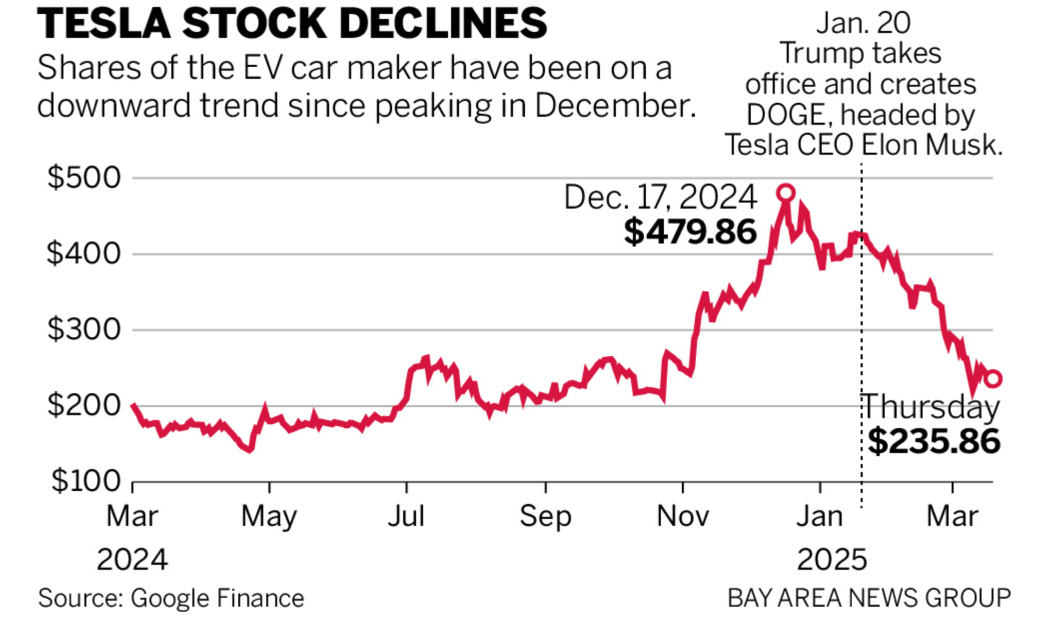
Introduction & Motivation
Tesla’s stock is highly volatile, driven by news, tweets, earnings, and investor sentiment.
Traditional models like GARCH capture volatility, but they don’t explain shifts in market behavior.
Regime-switching models (Hamilton, 1989) allow us to identify and forecast periods of:
Stable market behavior (Regime 0)
Panic or overreaction (Regime 1)
Q1 2025 was chosen due to notable price swings and lack of major macro events — ideal for exploring market irrationality.
This work offers insights for investors and even for Tesla’s leadership on how markets react beyond fundamentals.

Slide 3
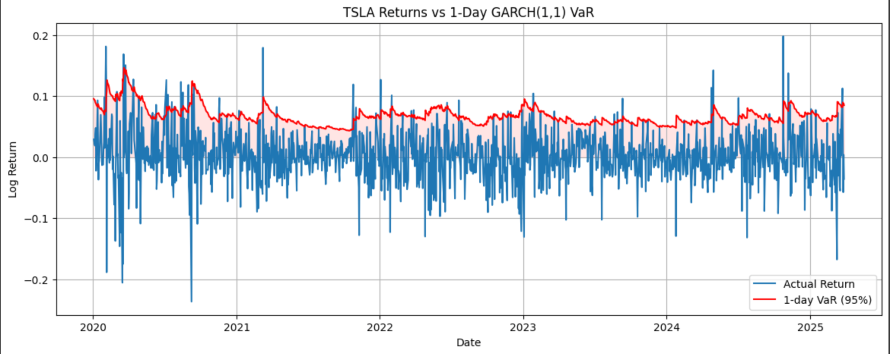
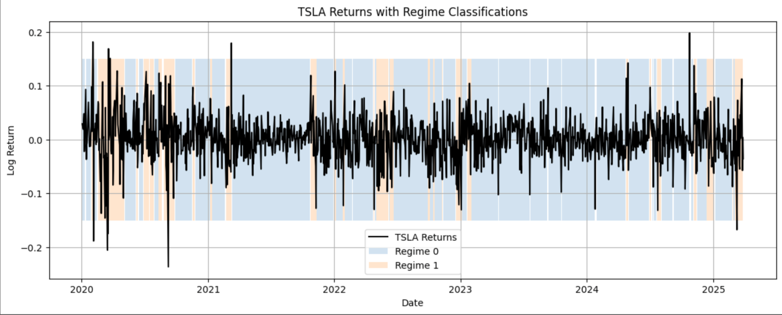
How I Modeled Tesla’s Risk Regimes
Collected TSLA daily stock prices and 13-week Treasury bill rates from Jan 1 to Mar 31, 2025
Calculated log returns and applied:
📈 GARCH(1,1) model to estimate traditional volatility
🔁 Markov Regime-Switching model (Hamilton, 1989) to capture shifts in market behavior
GARCH captures volatility clustering but assumes a single regime
Regime-switching allows for:
Different mean/volatility per regime
Transition probability estimation
Smoothed regime probabilities over time

Slide 4
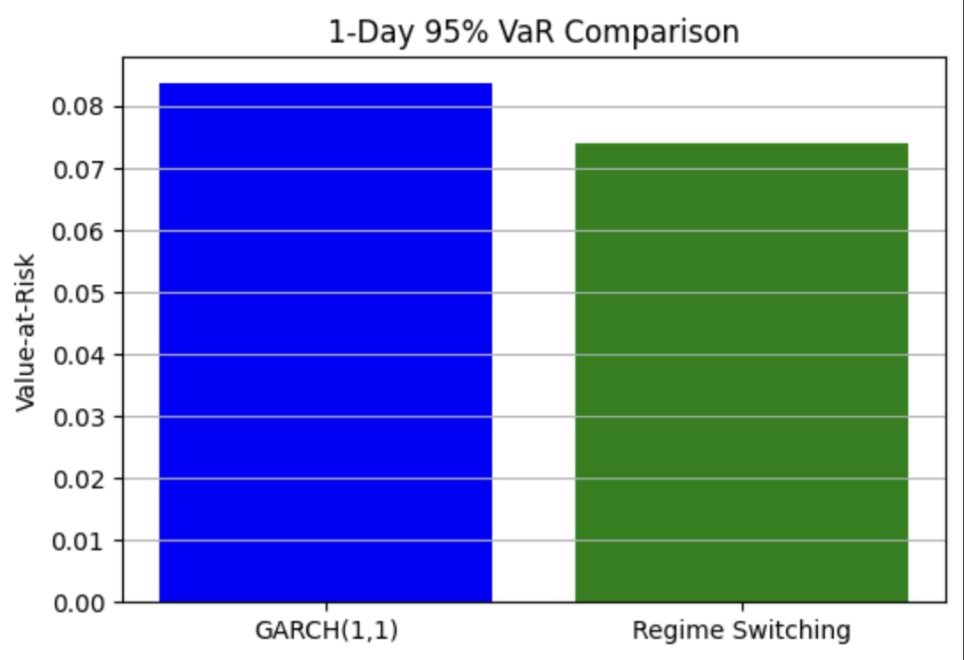
Key Results & Insights
Two distinct regimes identified:
Regime 0 → Stable returns, low volatility
Regime 1 → Elevated volatility, frequent negative returns
Markov-switching model assigned probabilities dynamically for each trading day
Key insight: Tesla entered high-volatility regimes without any major events (e.g., Jan 19–23, Mar 5–8) → Suggests investor overreaction or fear-driven behavior
GARCH model produced consistent volatility bands but missed regime changes
Regime-based VaR was more adaptive and risk-aware during stress

Slide 5
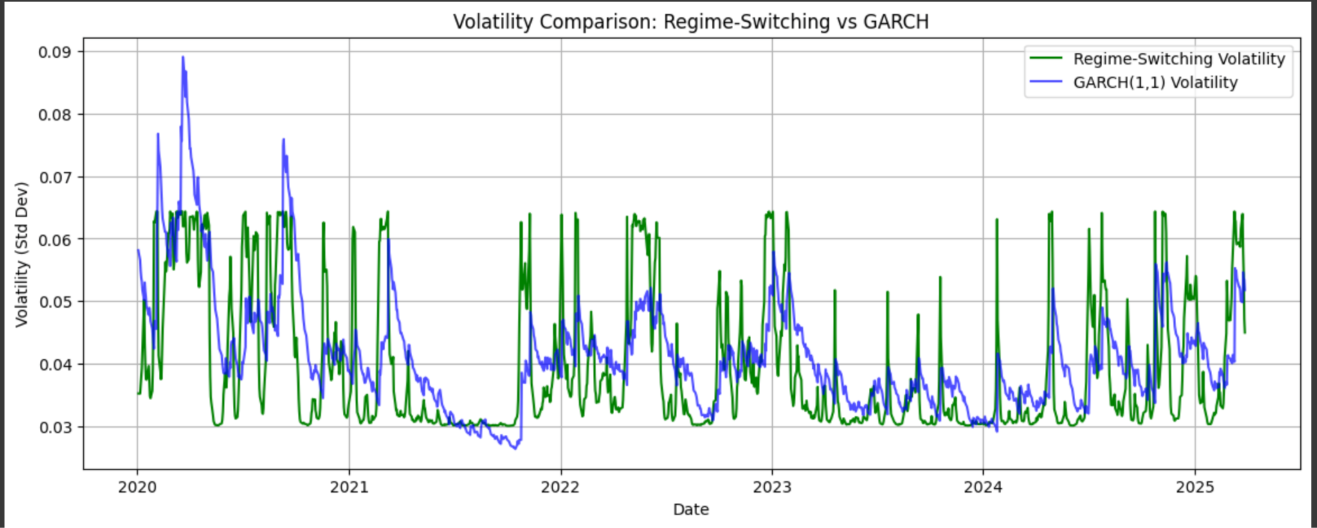
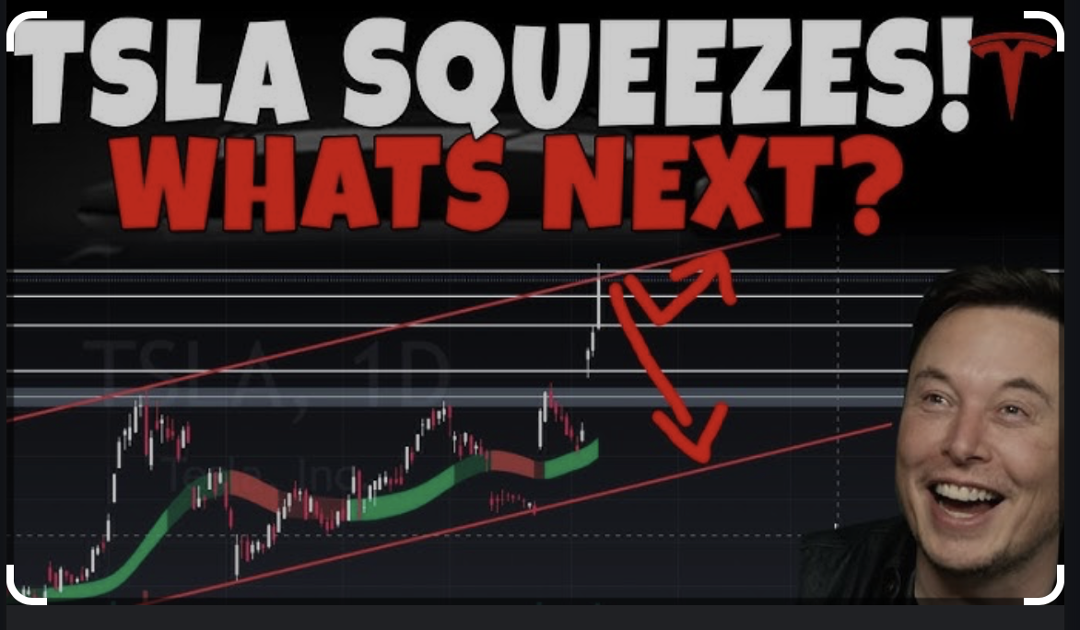
Why It Matters & What’s Next
Regime-switching models uncover hidden behavior patterns in TSLA's price movements
Useful for:
🚨 Detecting panic and fear-based investing
🧠 Decision timing (announcements, earnings, tweets)
📊 Improving risk forecasts beyond GARCH
This approach can help leaders like Elon Musk:
Spot market overreactions early
Stabilize investor sentiment proactively
Next Steps:
➕ Integrate macroeconomic signals (e.g., Fed rate hikes, CPI)
📰 Match live news sentiment with regime shifts using NLP
🔄 Apply this framework to other volatile assets like NVDA, Bitcoin, or AI stocks

Slide 6
THANK YOU

